Slide 1
Phytochrome and Photomorphogenesis
Prepared by
Ashish Sharma, Ph.D.

Slide 2
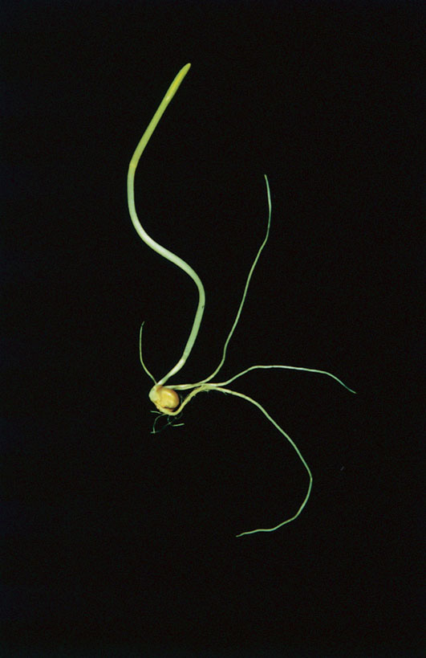
Seedlings grown in the dark have a pale, unusually tall and spindly appearance - etiolated growth.

Slide 3
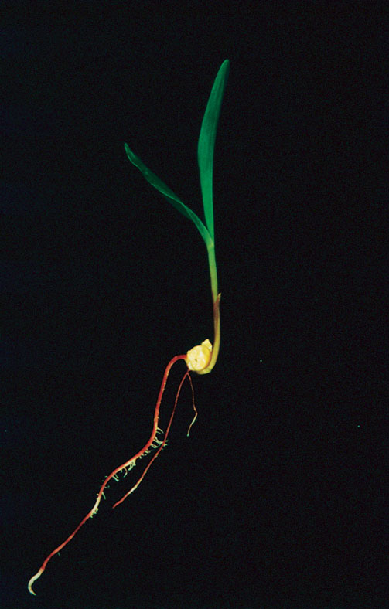
Regaining of color and strength of the seedling after the exposure to light is called as de-etiolation.
The response of plants to light leading to change in their morphological characters/ features is called as – PHOTOMORPHOGENESIS.

Slide 4
PHYTOCHROME
The pigment that can promote photomorphogenesis.
A blue protein pigment with a molecular mass of about 125 kDa.
Mediates photomorphogenesis responses to red (660 nm) and far-red (730 nm) light.
The response was first observed in relation to the seed germination response of lettuce seeds.

Slide 5
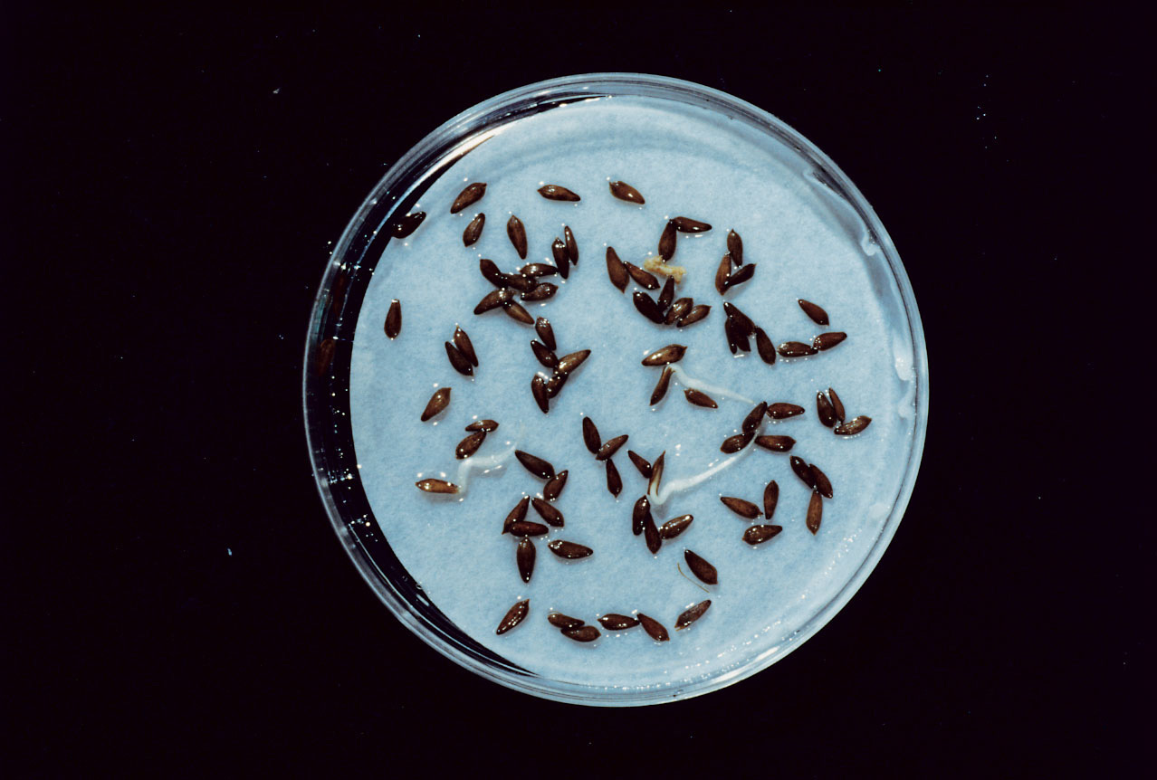
Dark
Notes:
PP1702a.jpg

Slide 6
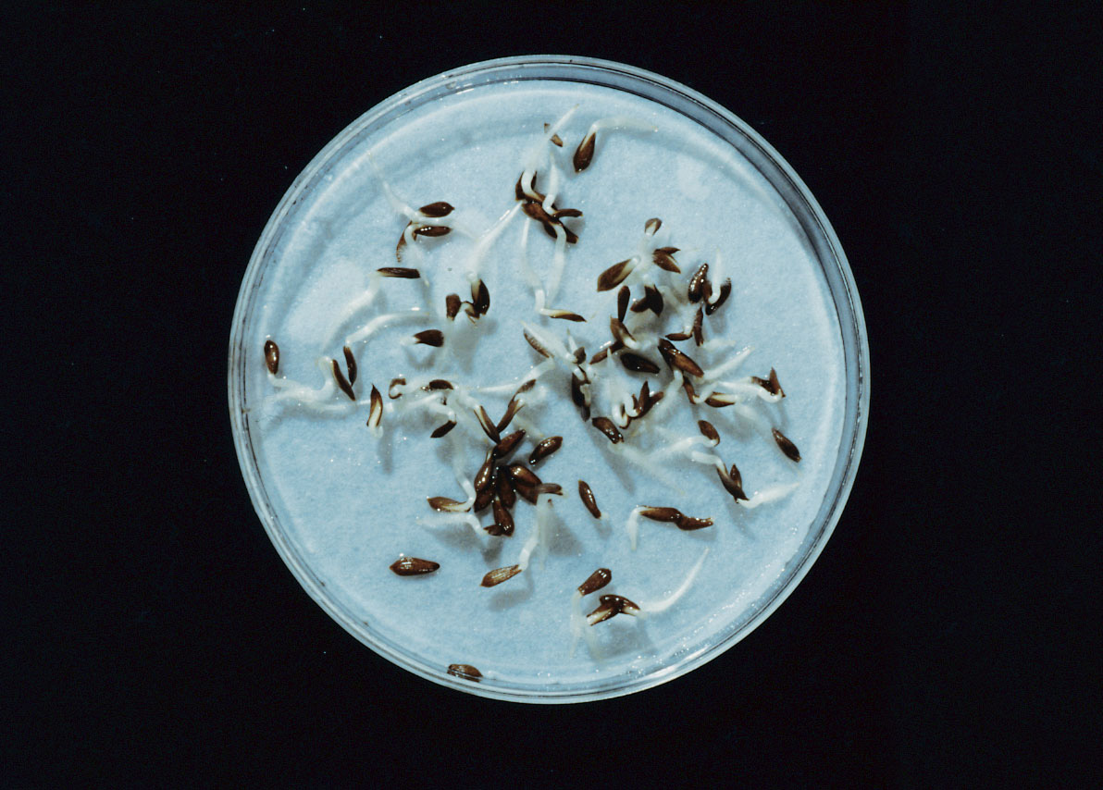
Red
Notes:
PP1702b.jpg

Slide 7
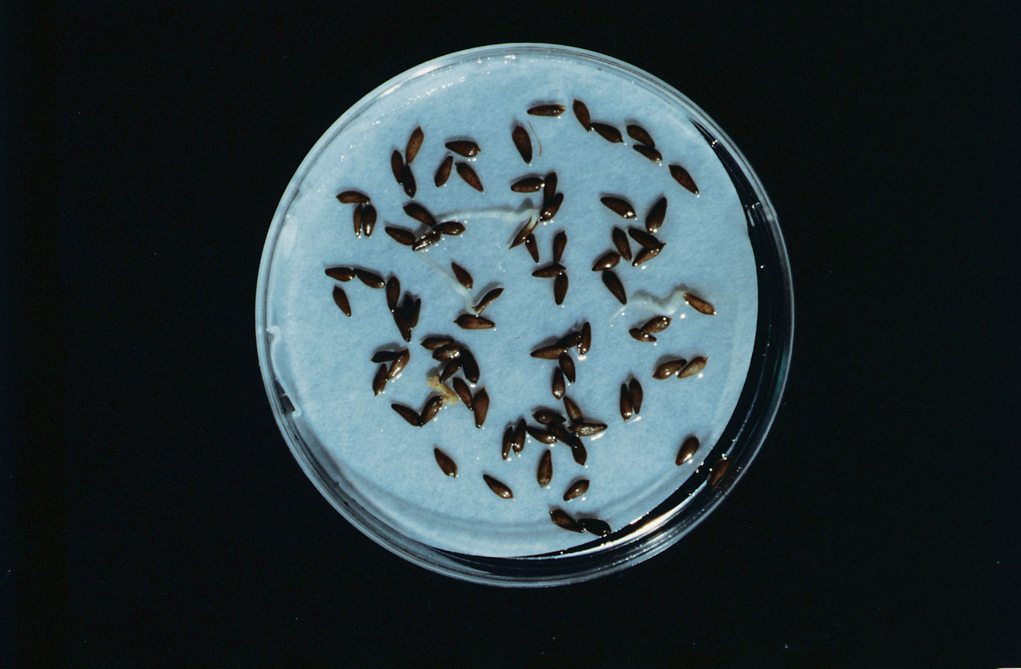
Red + Far Red
Notes:
PP1702c.jpg

Slide 8
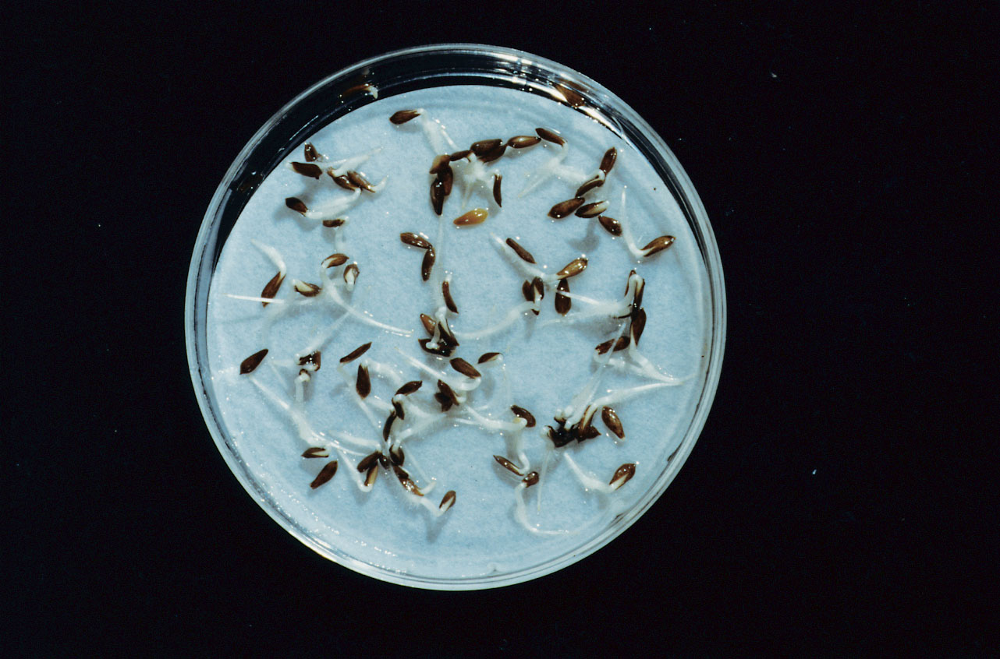
Red + Far Red + Red
Notes:
PP1702d.jpg

Slide 9
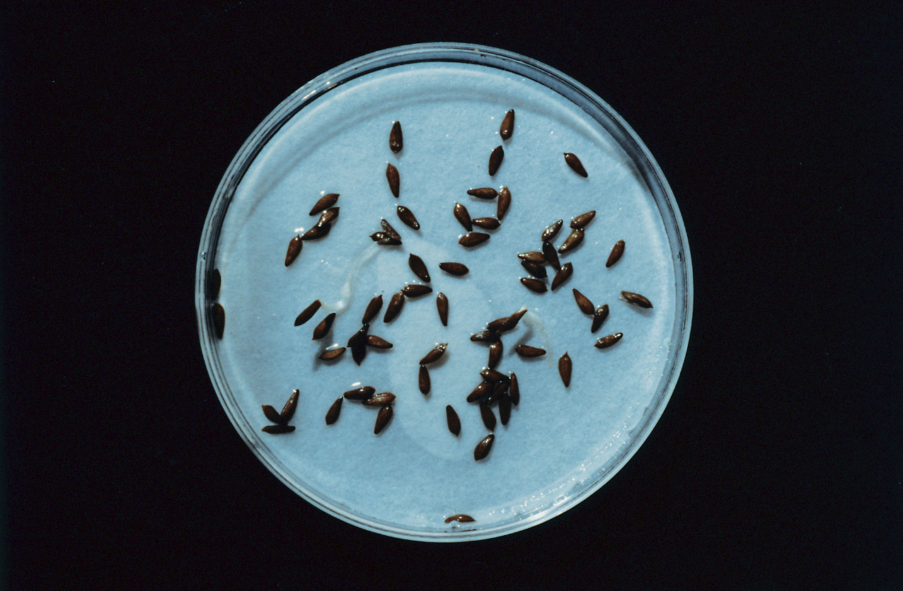
R + FR + R + FR
Notes:
PP1702e.jpg

Slide 10
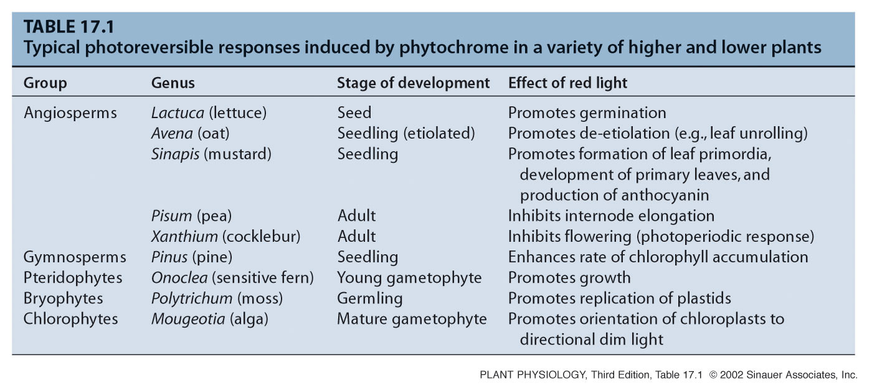
Different photoreversible responses induced by phytochrome in a variety of higher and lower plants
Notes:
PP17T010.jpg

Slide 11
Two interpretations of these results were possible:
1 - There are two pigments
2 - There might be a single pigment (Brothwick et al. 1952)

Slide 12
PHYTOCHROME CAN INTERCONVERT BETWEEN Pr AND Pfr FORMS
Red light
Pr Pfr
Far-red light
DARK

Slide 13
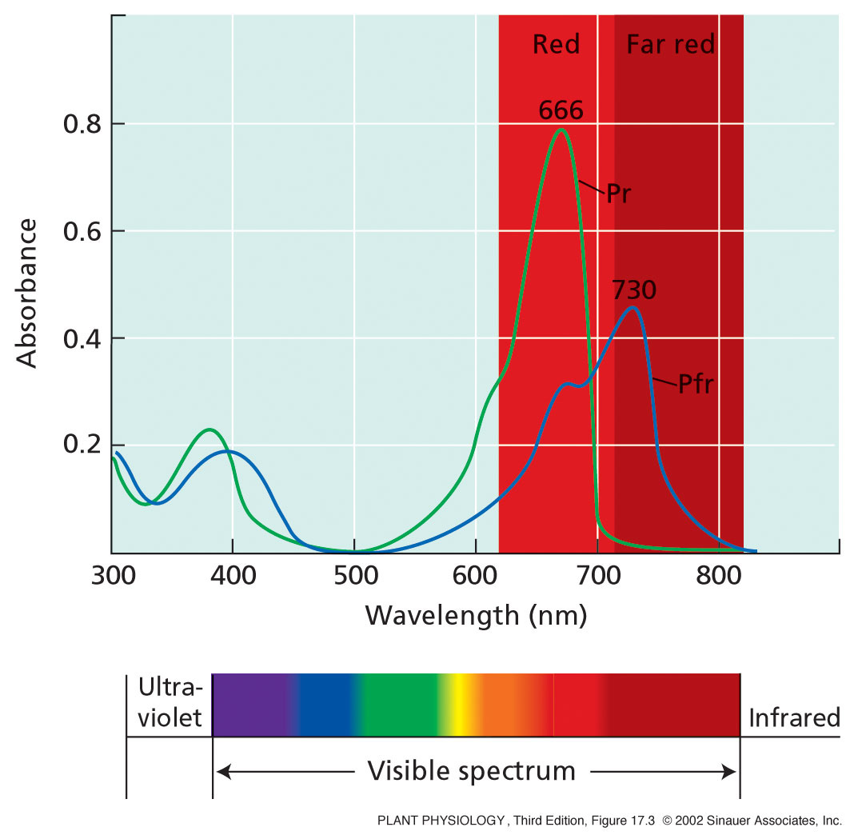

Slide 14
PHOTOSTATIONARY STATE - Red Light
When Pr molecules absorb red light, most are converted to Pfr.
Since Pfr molecules can also absorb red light (see absorption spectrum), some of the Pfr molecules are converted back to Pr.
Thus after saturating irradiation with red light, only about 85% conversion of Pr to Pfr occurs.

Slide 15
PHOTOSTATIONARY STATE - Far-red light
When Pfr molecules are exposed to far-red light, nearly all the molecules are converted to the Pr form.
Since Pr molecules absorb almost no far-red light, there is almost no back reaction from Pr to Pfr.
Thus, after saturating far-red light there is about 97% conversion of Pfr to Pr.

Slide 16
Pfr is the Physiologically Active Form of Phytochrome (Is phytochrome response due to build-up of Pfr or to the loss of Pr?)
In general, the magnitude of the physiological response to red light is proportional to the amount of Pfr produced.
In some cases the magnitude of the response is proportional to the ration of Pfr to Pr, or of Pfr to Ptot.

Slide 17
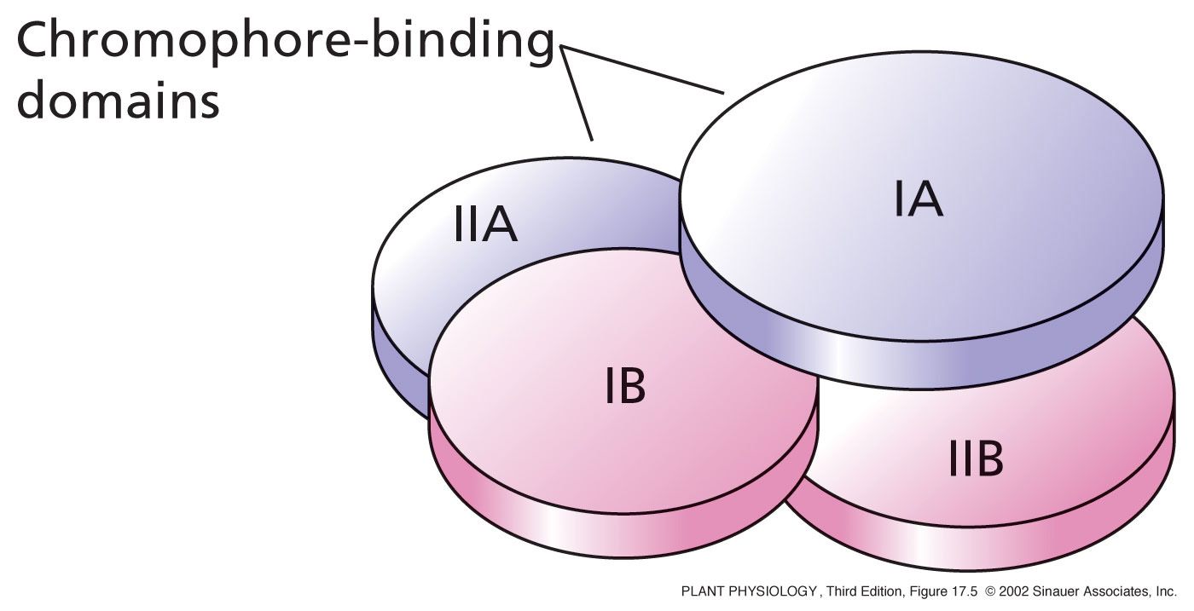
PHYTOCHROME IS A DIMER COMPOSED OF TWO POLYPEPTIDES
Notes:
PP17050.jpg

Slide 18
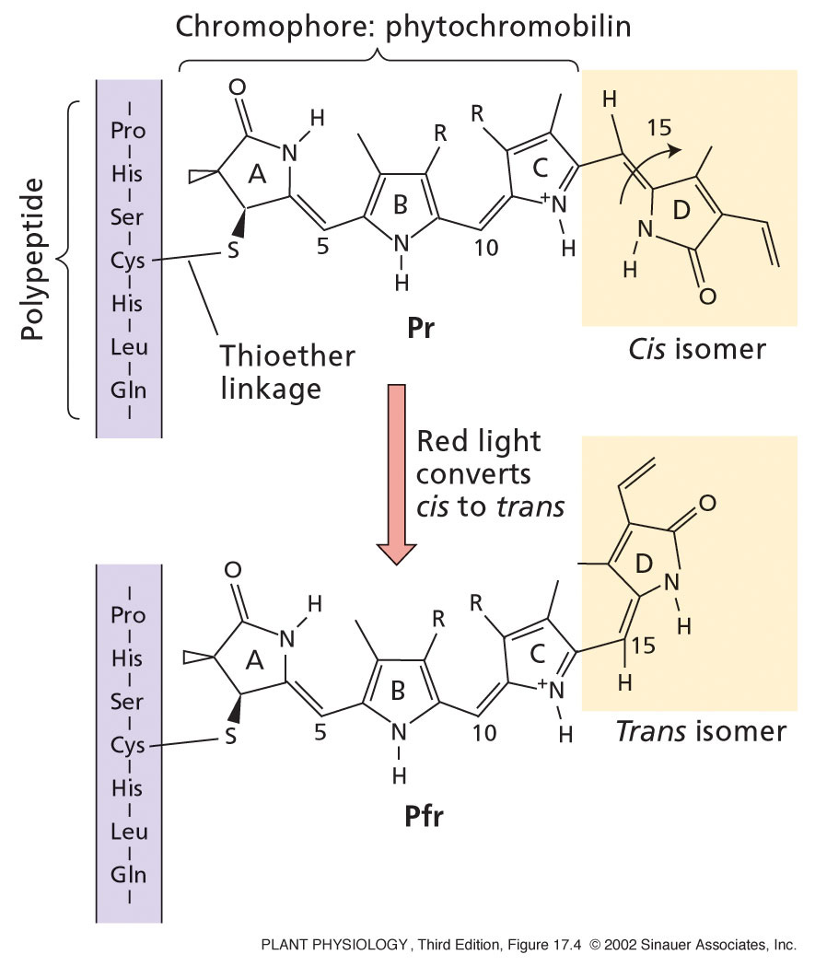
Synthesized in plastids
Notes:
PP17040.jpg

Slide 19
Two Types of Phytochrome Have Been identified
Type I
About 9X more abundant in dark-grown tissues.
The Pfr form is rapidly degraded.
c) The Pfr form feed-back inhibits its own synthesis.

Slide 20
Type II
Present in in equal amounts with Type I phytochrome in light-grown tissues.
The Pfr form is not degraded.
c) Synthesis of Type II phytochrome is not feed-back inhibited by Pfr.

Slide 21
Phytochrome is Encoded By a Multigene Family
1. Arabidopsis has five structurally related phytochrome genes: PHYA, PHYB, PHYC, PHYD, and PHYE.
2. PHYA is the only Type I phytochrome
3. PHYB - PHYE are all Type II phytochromes.

Slide 22
Types I and II Phytochromes are Regulated Differently
Red
1. PHYA mRNA Pr Pfr Response
Far-red
Ubiquitin + ATP
Degradation
Degradation
Red
2. PHYB-E mRNA Pr Pfr Response
Far-red

Slide 23
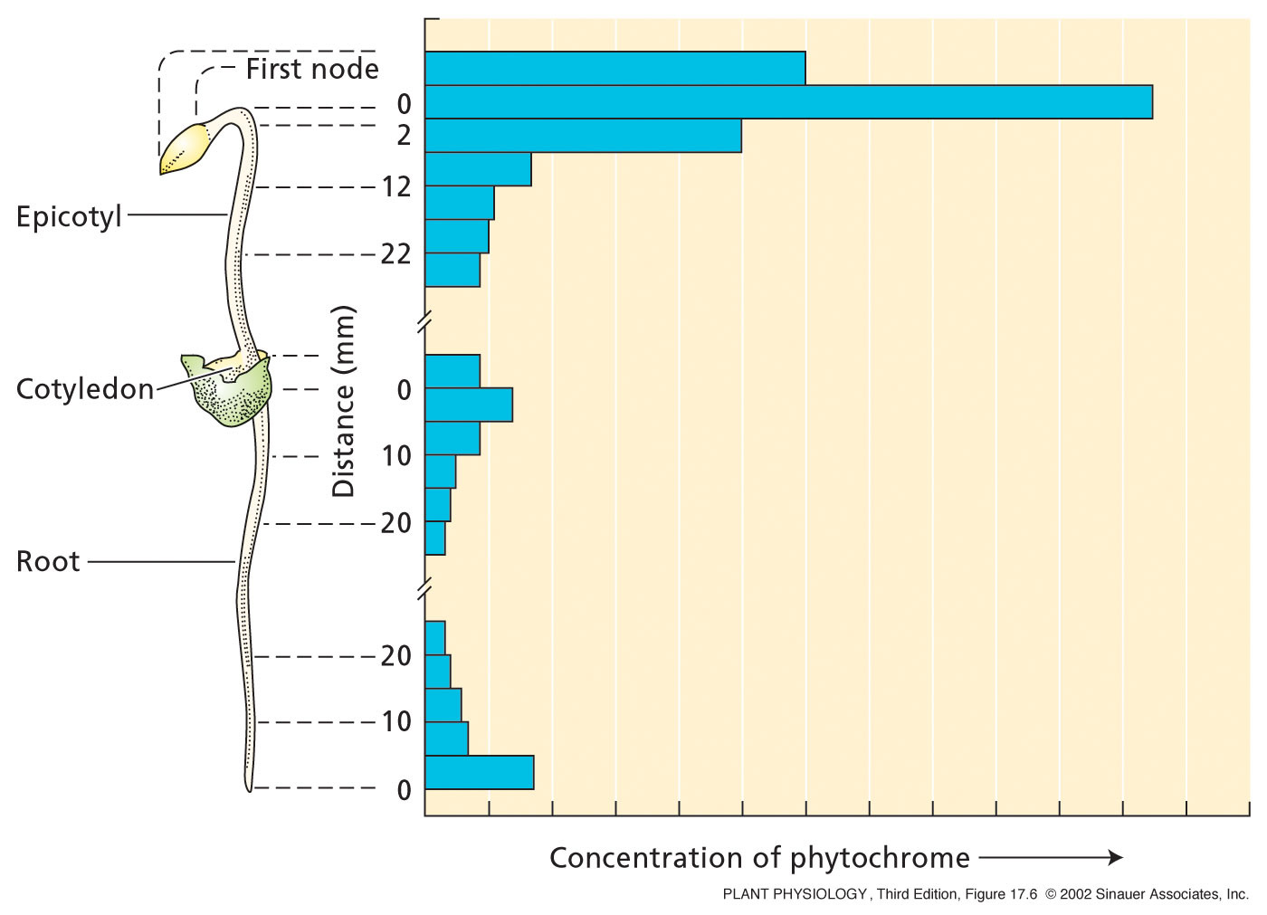
Notes:
PP17060.jpg

Slide 24
PHYTOCHROME RESPONSES VARY IN LAG TIME
LAG TIME - THE TIME BETWEEN THE STIMULUS AND THE OBSERVED RESPONSE
A PHYTOCHROME RESPONSES MAY BE RAPID (A FEW MINUTES) OR LONG TERM (SEVERAL WEEKS).

Slide 25
PHYTOCHROME RESPONSES VARY IN THE AMOUNT OF LIGHT REQURIED
A. FLUENCE - TOTAL NUMBER OF PHOTONS IMPINGING ON A UNIT SURFACE AREA (micromoles/m²)
VLFR - VERY LOW FLUENCE RESPONSE
LFR - LOW FLUENCE RESPONSE
B. IRRADIANCE - FLUENCE RATE; NUMBER OF PHOTONS IMPINGING ON UNIT SURFACE AREA PER UNIT TIME (micromoles/m²/s)
1. HIR - HIGH IRRADIANCE RESPONSE

Slide 26
VLFRs
Some phytochrome responses can be initiated by fluences as low as 0.0001 μmol m^{–2}, and they saturate at about 0.05 μmol m^{–2}.
For example: Arabidopsis seeds can be induced to germinate with red light in the range of 0.001 to 0.1 μmol m^{–2}.
Less than 0.02% of the total phytochrome converted to Pfr.
Because the far-red light converts 97% of the Pfr to Pr, about 3% of the phytochrome remains as Pfr—significantly more than is needed to induce VLFRs.
Thus, far-red light cannot reverse VLFRs.

Slide 27
LFRs
Cannot be initiated until the fluence reaches 1 μmol m^{–2} – saturated at 1000 μmol m^{–2}.
They include most of the red/far-red photoreversible responses.
Both VLFRs and LFRs can be induced by brief pulses of light, provided that the total amount of light energy adds up to the required fluence.
Two factors: the fluence rate (mol m^{–2} s^{–1}) and the irradiation time.
This reciprocal relationship between fluence rate and time is known as the law of reciprocity, which was - R. W. Bunsen and H. E. Roscoe in 1850.
VLFRs and LFRs both obey the law of reciprocity.

Slide 28
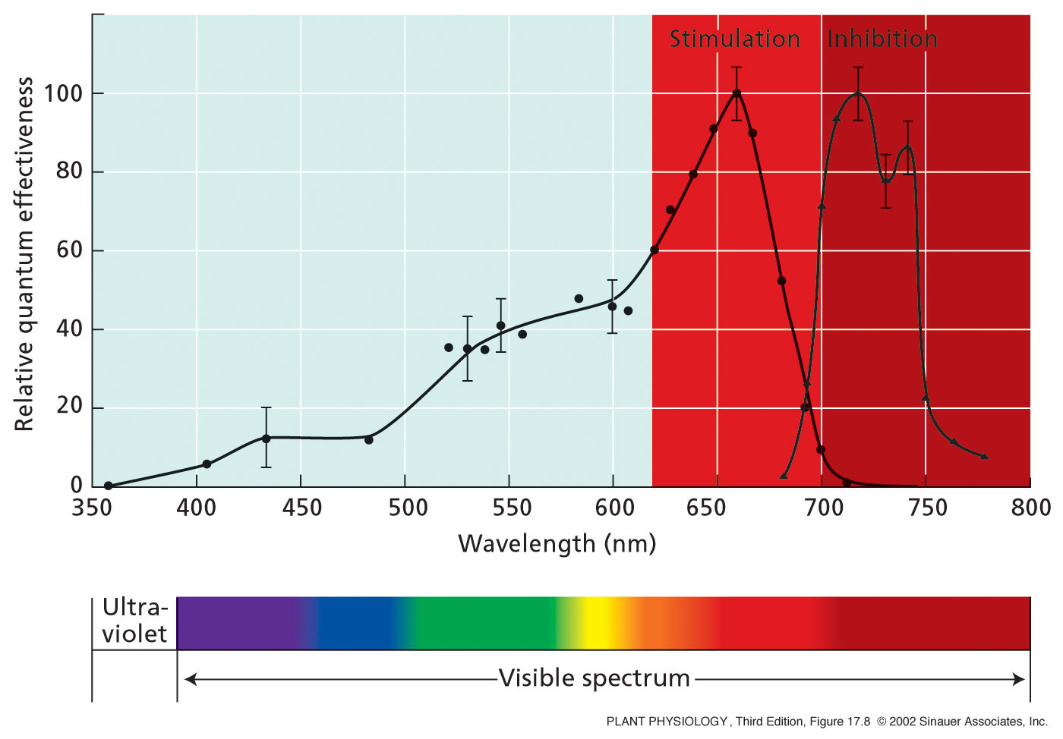
Notes:
PP17080.jpg

Slide 29
PHYTOCHROME RESPONSES VARY IN THEIR RECIPROCITY
LAW OF RECIPROCITY -
FLUENCE = FLUENCE RATE X TIME
(micromoles/m²) = (micromoles/m²/sec) X (sec)
B. According to the Law of Reciprocity, treating plants with a brief duration of high fluence rate (bright) light will five the same response as treating them with a long duration of low fluence rate (dim) light.
C. Reciprocity applies to most photochemical reactions, like the exposure of film.

Slide 30
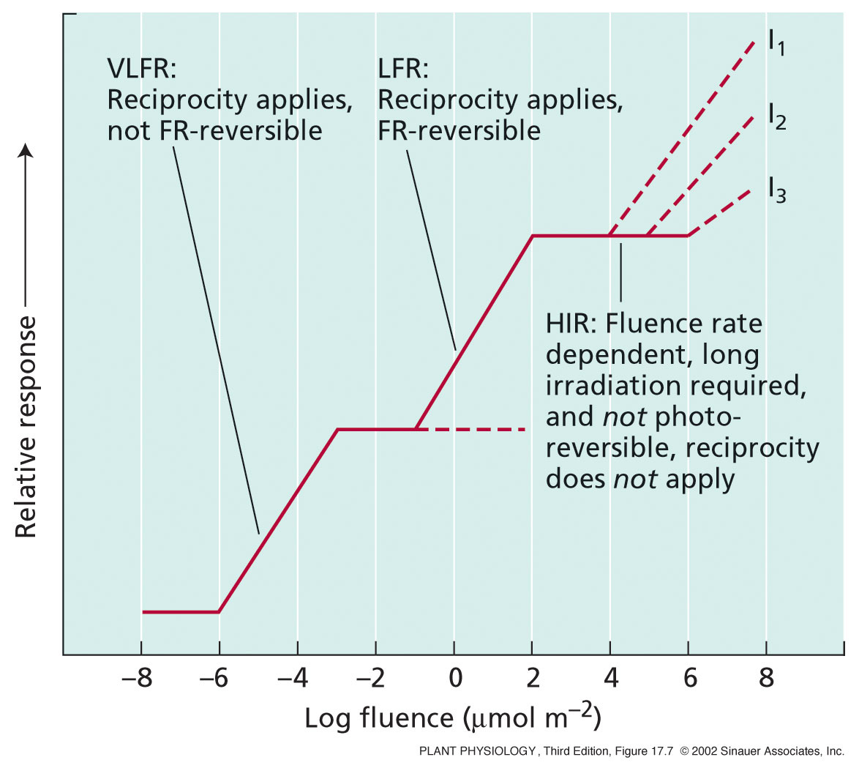
Notes:
PP17070.jpg

Slide 31
HIRs
Require prolonged or continuous exposure to light of relatively high irradiance.
Proportional to irradiance (the brightness of the light) rather than fluence.
HIRs saturate at much higher fluences than LFRs—at least 100 times higher
Not photoreversible.
HIRs do not obey the law of reciprocity.

Slide 32
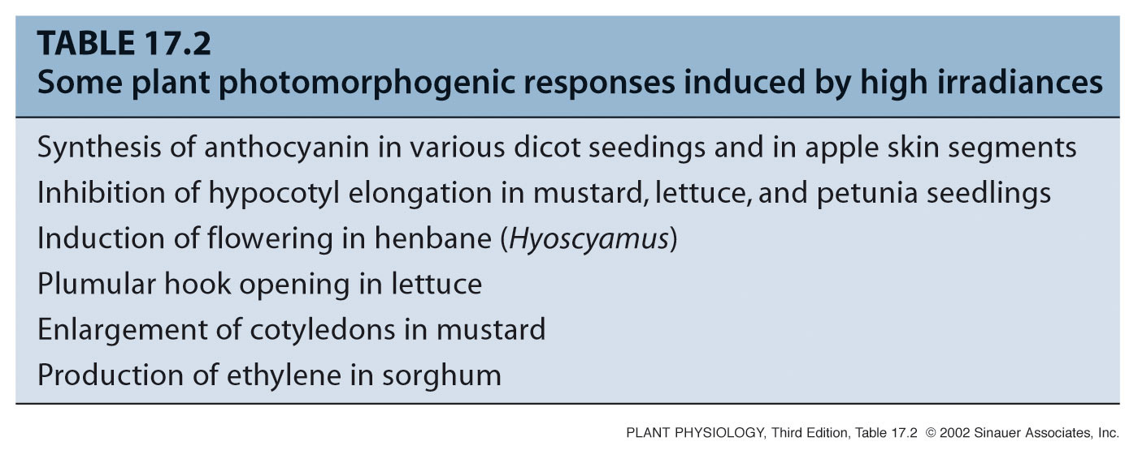
Notes:
PP17T020.jpg

Slide 33
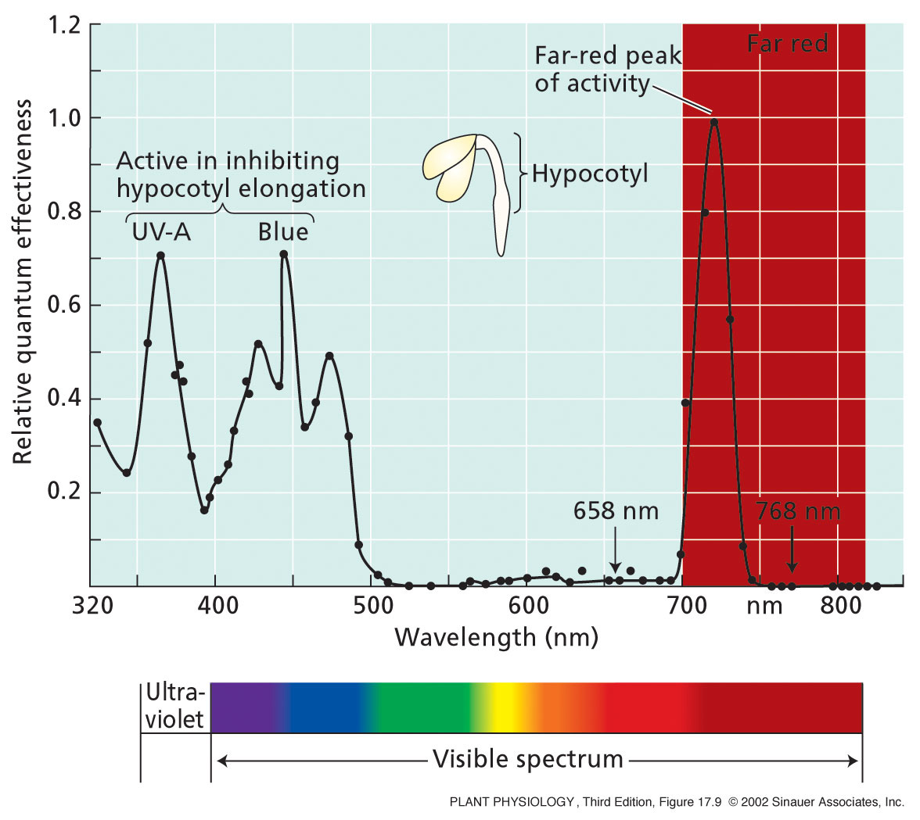
Notes:
PP17090.jpg

Slide 34
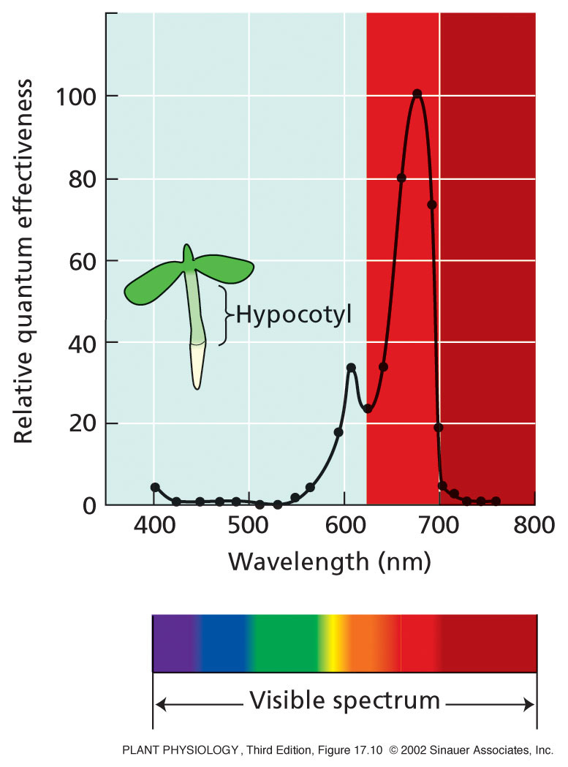
Notes:
PP17100.jpg

Slide 35
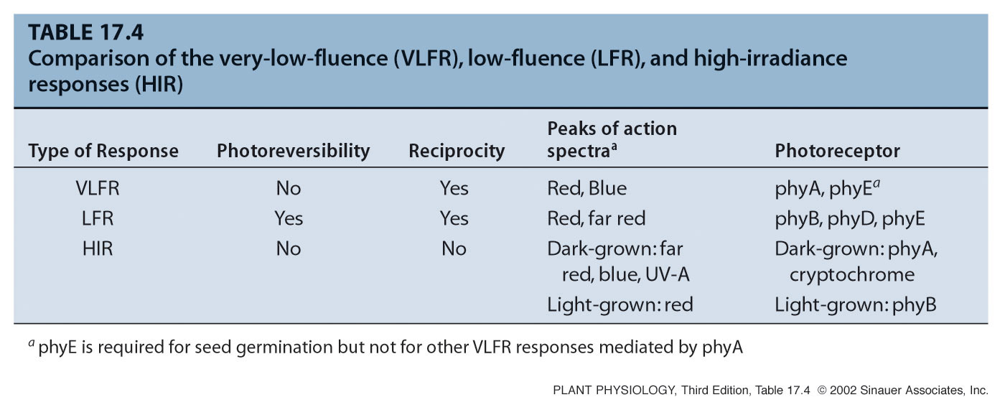
Notes:
PP17T040.jpg

Slide 36
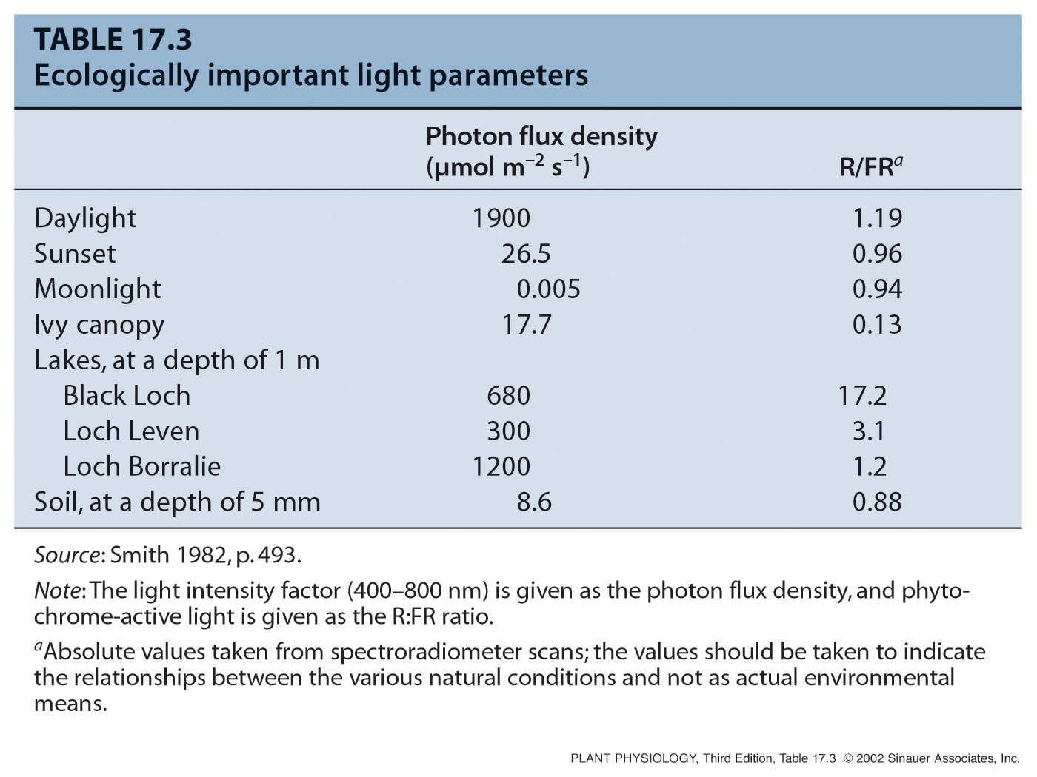
ECOLOGICAAL FUNCTIONS OF PHYTOCHROME: SHADE AVOIDANCE
Phytochrome Enables Plants to Adapt to Changing Light Conditions

Slide 37
ECOLOGICAL FUNCTIONS OF PHYTOCHROME: SHADE AVOIDANCE
Phytochrome enables plants to sense shading by other plants.
Plants that increase stem extension in response to shading are said to exhibit a shade avoidance response.
As shading increases, the R:FR ratio decreases.
Simulated canopy shading induces sun-plants to grow taller.
This correlation did not hold for “shade plants”.

Slide 38
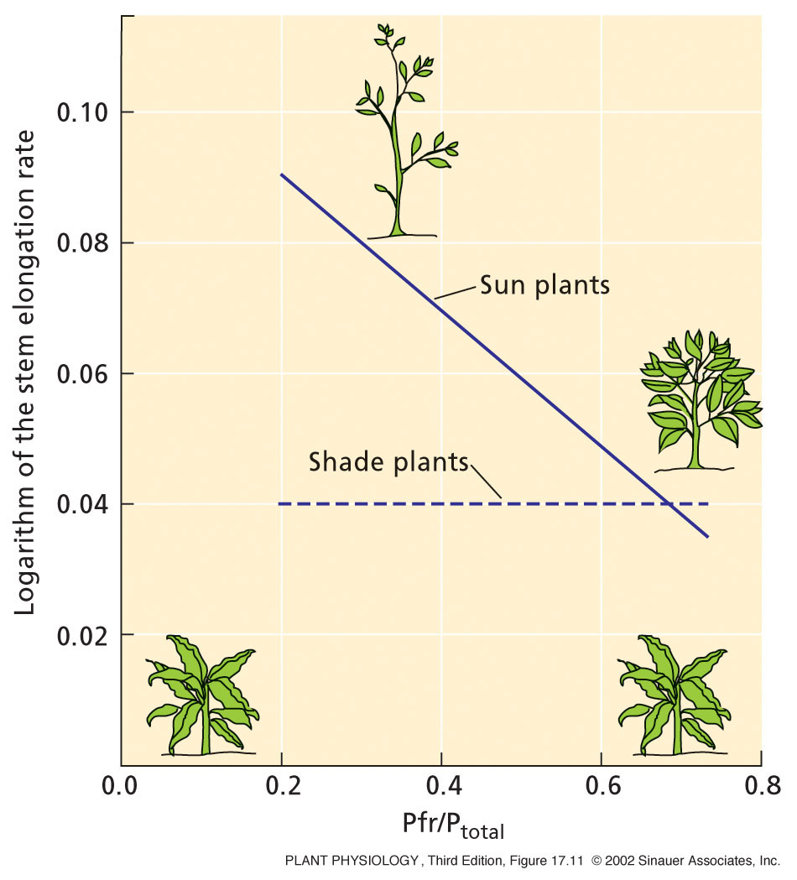
Notes:
PP17110.jpg

Slide 39
ECOLOGICAL FUNCTIONS OF PHYTOCHROME: CIRCADIAN RHYTHM
CIRCADIAN RHYTHM = APPROXIMATELY A DAY
PERIOD = TIME BETWEEN SUCCESSIVE PEAKS OR TROUGHS IN A CYCLE
ENDOGENOUS RHYTHM = UNAFFECTED BY EXTERNAL STIMULI; REGULATED BY INTERNAL FACTORS
OSCILLATOR = BIOLOGICAL CLOCK MECHANISM
TEMPERATURE COMPENSATION = RHYTHM UNAFFECTED BY TEMPERATURE
ENTRAINMENT = ABILITY OF A STIMULUS (TYPICALLY LIGHT) TO RESET OR SYNCHRONIZE THE RHYTHM.

Slide 40
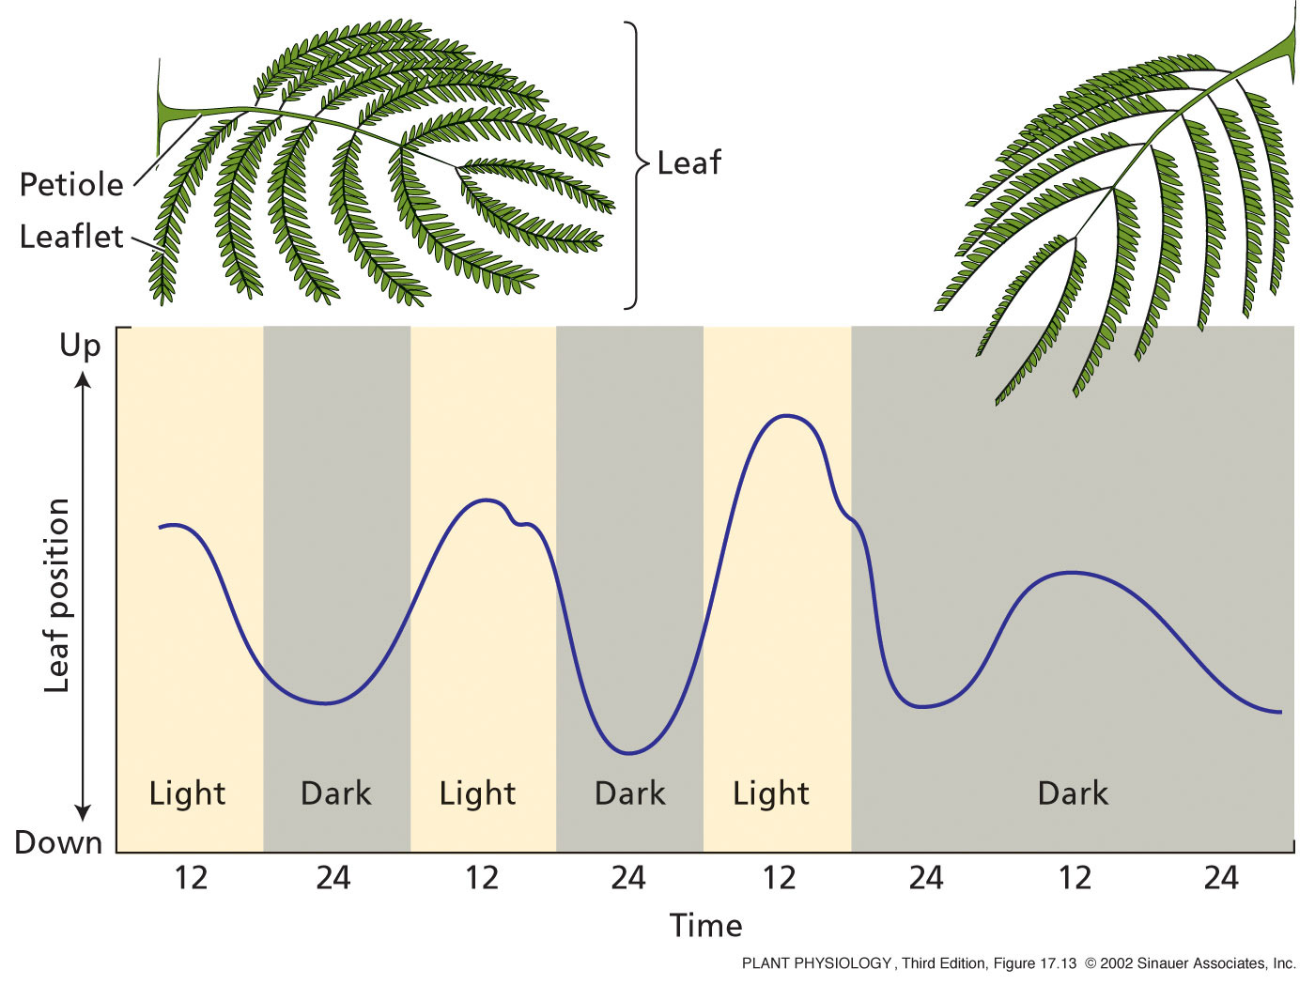
Notes:
PP17130.jpg

Slide 41
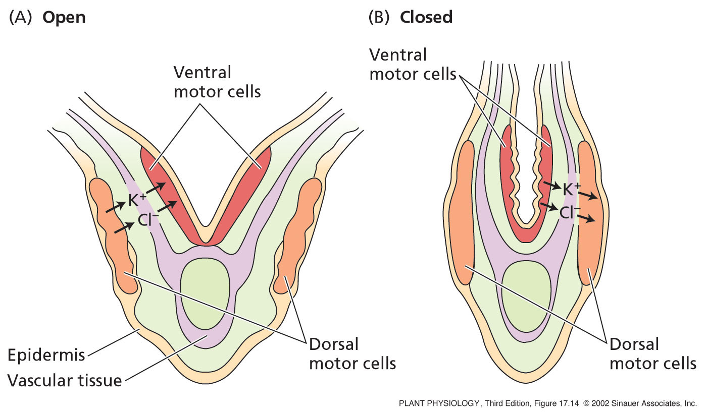
Notes:
PP17140.jpg

Slide 42
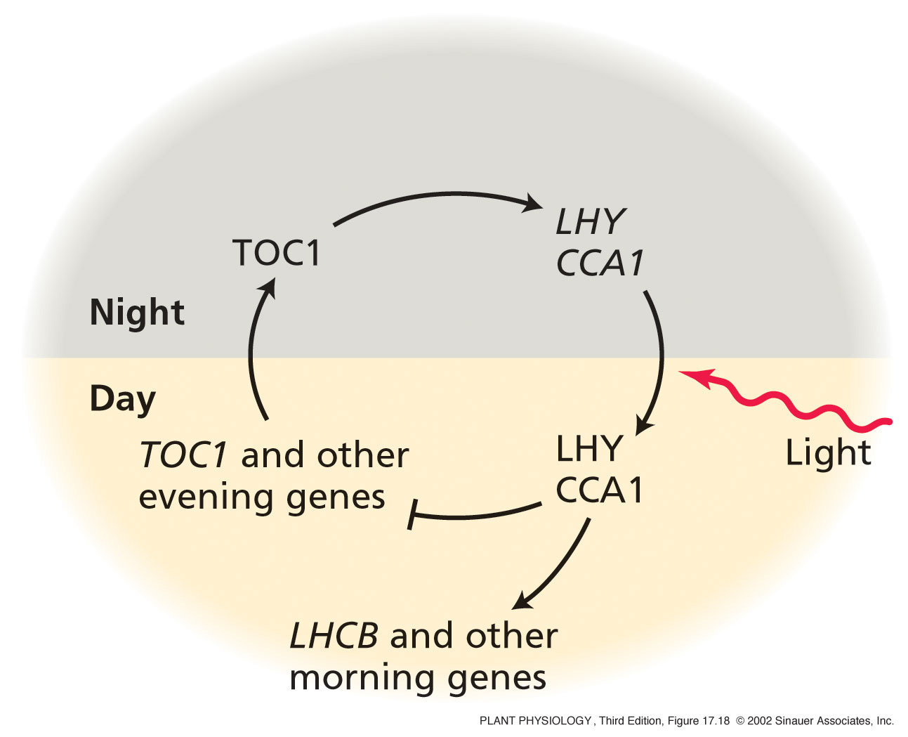
THE CIRCADIAN OSCILLATOR INVOLVES A TRANSCRIPTIONAL NEGATIVE FEEDBACK LOOP
Notes:
PP17180.jpg

Slide 43
DIFFERENT PHYTOCHROMES HAVE DIFFERENT ECOLOGICAL FUNCTIONS
PHYTOCHROME B MEDIATES THE RESPONSE TO CONTINUOUS RED OR WHITE LIGHT
PHYTOCHROME A IS REQUIRED FOR THE RESPONSE TO CONTINUOUS FAR-RED LIGHT
PHYA AND PHYB CAN HAVE MUTUALLY ANTAGONISTIC EFFECTS

Slide 44
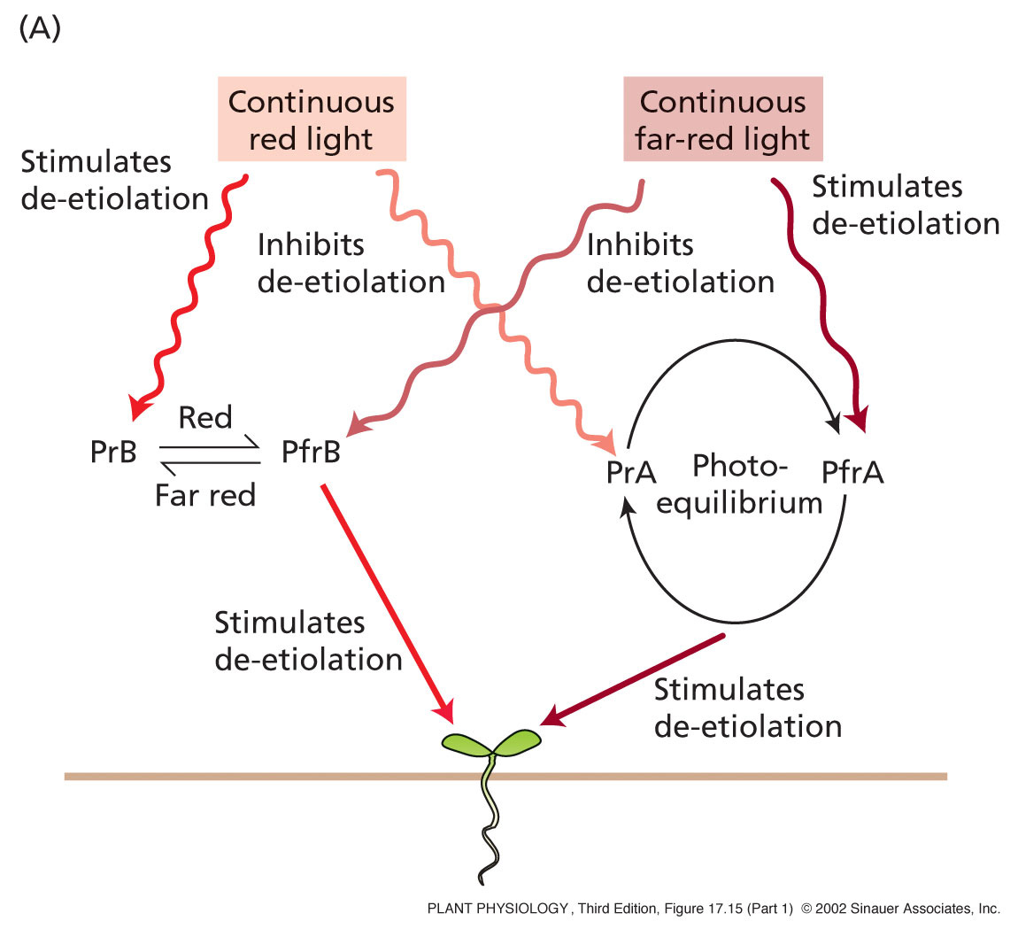
Notes:
PP17151.jpg

Slide 45
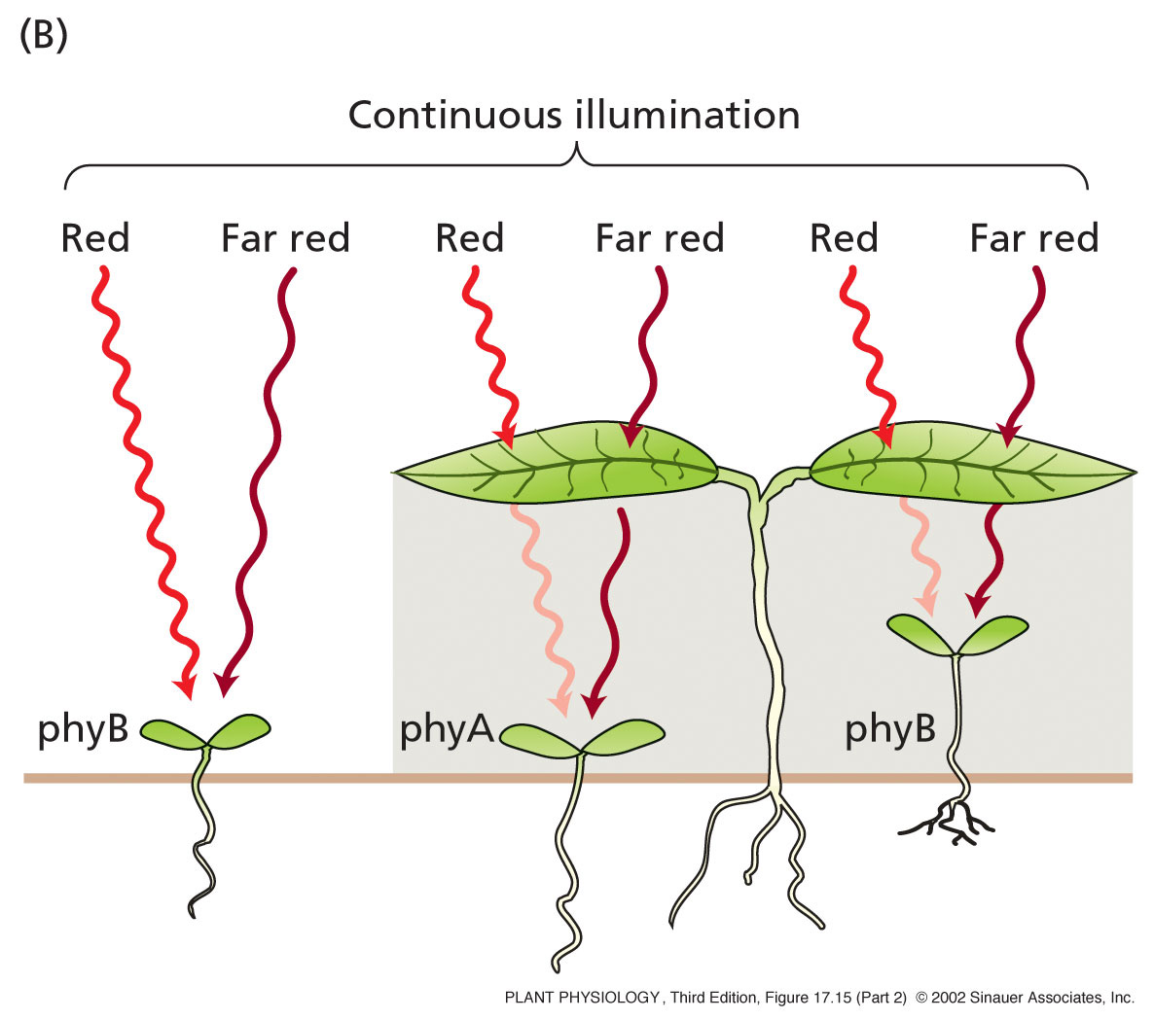
Notes:
PP17152.jpg

Slide 46
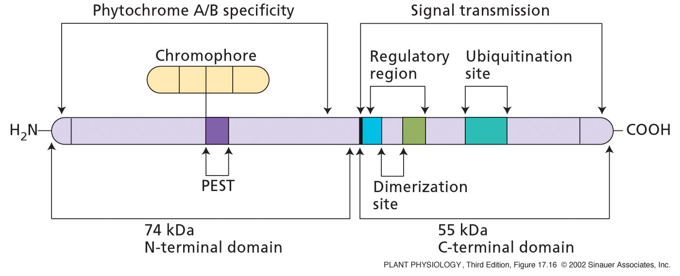
Notes:
PP17160.jpg

